Slide 1
"Hey, That Happened to Me!": Culturally Relevant Literature and Strategies for Adolescent ELs
TESOL National Convention
March 20-22, 2013; Dallas, TX
Lois Knezek, Carol Revelle, and
Mandy Stewart, University of North Texas
Juan Araujo, UNT Dallas

Slide 2
Adolescents and Literature
Adolescents work through struggles in books (Glenn, 2008).
They are looking to find their way and books provide guidance during an optimal period of development (Tatum, 2008).
Students need to experience what they read and connect to it meaningfully (Rosenblatt, 1991).
Teachers should include “moderns among the masterpieces” (Rosenblatt, 1940).
How often does this occur?

Slide 3
Literature about the Immigrant Experience
There are issues in children’s literature that help immigrants cope (Baghban, 2007).
Themes missing in children’s literature about immigration
Discrimination
Legal issues
People without a homeland (Lamme, Fu, Lowry, 2004)

Slide 4
Relevant Texts with Diverse Students
Athanases (1998):“Identifying culturally with literary events provided some students with pride and special access to the works.”
Vyas (2004): 1st- and 2nd-generation Asian high school students in an after school book club
Helped students negotiate their cultural identities

Slide 5
Relevant Texts Cont’d
Feger (2006): Latino high school English Learners
Students became more engaged in reading when the teacher abandoned the basal readers and chose texts that mirrored the students’ lived experiences.

Slide 6
Beginning EL Characteristics
Have little or no ability to understand spoken English used in academic and social settings.
Have little or no ability to speak English in academic and social settings.
Have little or no ability to use the English language to build foundational reading skills.
Have little or no ability to read and understand English used in academic and social contexts.

Slide 7
Beginning EL Characteristics
Have little or no ability to use the English language to build foundational writing skills.
Lack the English vocabulary and grasp of English language structures necessary to address grade-appropriate writing tasks meaningfully.

Slide 8
The Role of L1
The first type possesses first language proficiency.
Native-like L1 learners
Apply L1 rules as they learn English
The second type has limited L1 proficiency.
Do not have a firm grasp in both languages (K-2)
Apply L2 rules when they use L1.

Slide 9
What Works with Beginners
Listening
Opportunities for rich and varied experiences
Speaking
One-on-one or small group (4 or less)
Reading
Mirrors life experiences
Promotes incidental connections
Writing
Integrating L1
Interactive writing
Multi-Genre Projects
Focusing on content not format

Slide 10
Teaching Vocabulary to English Learners
There are 180,000 English word families (Zeno, Ivens, Millard, Duvvuri, 1995).
By 12th grade a typical student knows about 50,000 words families (White, Graves,& Slater, 1990).
Beginning ELs need direct, focused vocabulary development.

Slide 11
Activity 1

Slide 12
Featured Books
Conkling, W. (2011). Silvia and Aki. Berkeley, CA: Tricycle Press.
Saenz, B. A. (2008). He forgot to say goodbye. NY: Simon & Schuster Books.
Sanchez, A. (2012) Bait. NY: Simon & Schuster Books.
Tafolla, C. (2009). What do you do with a palleta? Berkeley, CA: Tricycle Press.
Tonatium, D. (2011). Diego Rivera his world and ours. New York: Abrams Books.

Slide 13
Bibliography
Graves, M. F., August, D., & Mancilla-Martinez, J. (2012). Teaching vocabulary to English language learners. NY: Teachers College Press.
White, T. G., Graves, M. F., Slater, W. H. (1990). Growth of reading vocabulary in diverse elementary schools. Decoding and word meaning. Journal of Educational Psychology, 82, 281-290.
Zeno, S. M., Ivens, S. H., Millard, R. T., Divvuri, R. (1995). The educator’s word frequency guide. Brewster, NY: Touchstone Applied Science Associates.

Slide 14
Intermediate ELs
They have developed some degree of fluency in their writing
Relatively large sight vocabulary and automaticity in reading
Can speak English well enough to negotiate meaning in a discussion group
Needs: Develop academic vocabulary, sustained reading in English

Slide 15
Strange Parents
Castilla, J. M. (2009). Strange parents. Houston, TX: Piñata Books.
Having spent most of her life living with her grandmother in Mexico, thirteen-year-old Marisol reluctantly travels to Fort Worth, Texas, to be reunited with parents she has not seen in ten years and a brother she has never met

Slide 16
Think-Write-Pair-Share
Read aloud by teacher: Page 18
Question: Have you moved (or visited) somewhere that was different from your home?
What did you see, hear, feel, taste, or smell?
Think about your response
Write in your journals
Pair up
Share a response with the group

Slide 17
Additional Tasks
Students re-read the chapter on their own for more exposure to comprehensible input and fluency practice.
Students choose one of their journal entries to turn into a published piece of writing as they go through the writing process.

Slide 18
Advanced ELs
In academic and social settings (with some support)
Can understand grade-appropriate spoken English
Participates comfortably in most conversations and academic discussions
Has enough vocabulary and command of the English language to write in a grade appropriate manner
Can read and understand grade-appropriate English

Slide 19
Why read online?
ELs are already online
Higher engagement
Multi-media
Audio and visual
Community of readers
Social media
Share culture and ideas

Slide 20
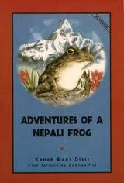
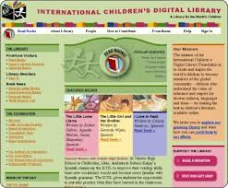
Culturally Relevant Online Text
International Children’s Digital Library
Example
Adventures of a Nepali Frog

Slide 21
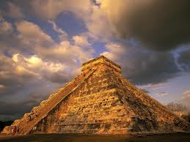
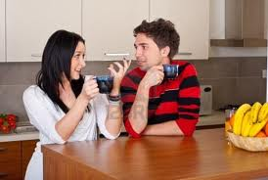
Culturally Relevant Online Text
Blogs and wikis
Travel destinations
Conversations

Slide 22
Example Websites
Interactive news stories
http://literacynet.org/cnnsf/home.html
International Children’s Digital Library
http://en.childrenslibrary.org/
Student conversations
http://coasttocoast.pbworks.com/w/page/15273075/Conversations
Digital storytelling
http://nativehealth.org/gallery/video/view/93

Slide 23
Strategies for online reading (similar to print reading)
Preview
Prior knowledge
Key words
Bolded words or sections
Pre-teach/preview vocabulary
Pair advanced with advanced high or bilingual classmates

Slide 24
Characteristics of Digital Reading
Non-linear
Hierarchical
Webbed
Shift between reader and navigator
Reader – uses web document as if print
Navigator – uses web document as a medium

Slide 25
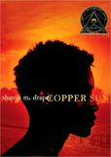
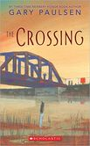
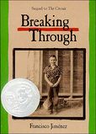
Advanced High ELs
Literature circles that differentiate for ability, culture, gender, genre, and interests.
Book Pass
Poetry Responses
Reader’s Theater

Slide 26
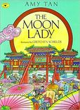
Advanced High ELs
Book Pairings

Slide 27
Culturally Relevant Literature
Places to find diverse adolescent/YA literature:
Arab American Book Awards
Asian Pacific American Awards for Literature
Notable Books for a Global Society
Pura Belpré Awards
Skipping Stones Honor Awards
Tomás Rivera Mexican American Children’s Book Awards
Worlds of Words (wowlit.org)

